Slide 1



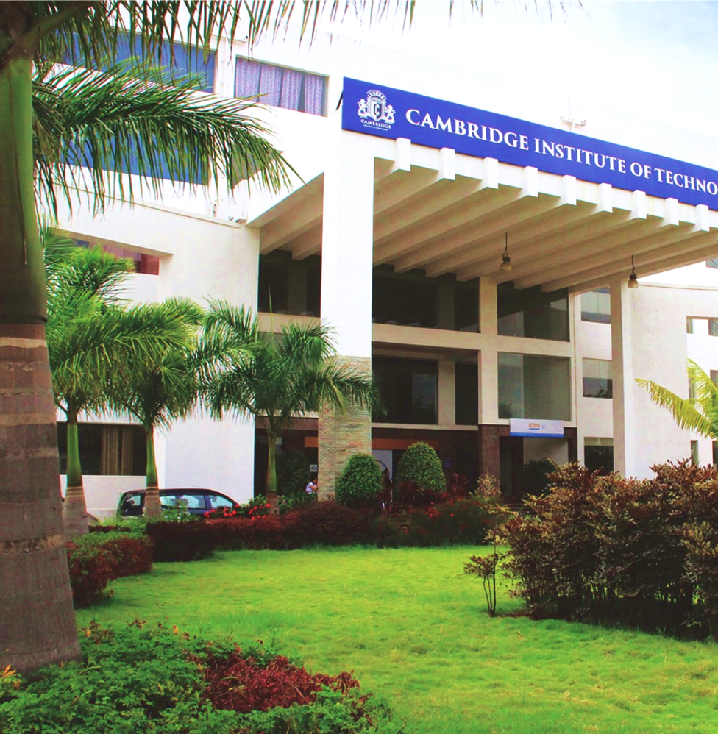
Department of Electronics & Communication Engineering
VISVESVARAYA TECHNOLOGICAL UNIVERSITY
JNANA SANGAMA, BELAGAVI-590018, KARNATAKA
Project Report Presentation 2024-25
Subject: Project Work final presentation (BEC786)
TITLE : A FLEXIBLE FPGA APPROACH TO IMAGE CRYPTOGRAPHY
Project Group Number:19
RAGHAVENDRA S MASHYAL 1CD22EC133
LAGINENI SREENITHAI 1CD22EC082
CHANDRAKIRAN S MITHARE 1CD22EC034
MULUKURI VALLESH NATH 1CD22EC178
Project Mentor:
Prof. CHAITHRA S

Slide 2

TABLE OF CONTENTS
ABSTRACT
INTRODUCTION
LITERATURE SURVEY
BLOCK DIAGRAM OF PROJECT
METHODOLOGY
COMPONENTS REQUIRED
FLOW CHART
PYTHON IMPLEMENTATION
OUTCOME
APPLICATION
CONCLUSION
REFERENCES
Department of Electronics & Communication Engineering
Project Work Phase 2 (BEC786)

Slide 3
ABSTRACT
In the rapidly evolving landscape of digital media, ensuring the confidentiality and integrity of image transmission has become a critical priority, particularly within medical diagnostics, industrial surveillance, and IoT networks. Traditional software-based encryption methods often face significant bottlenecks when run on General-Purpose Processors (GPPs), failing to meet the strict latency and throughput requirements of modern real-time systems. To address these limitations, this project presents a robust Hardware/Software Co-design cryptography scheme implemented on the PYNQ-Z2 development board. By leveraging the Xilinx Vivado High-Level Synthesis (HLS) toolchain, computationally intensive encryption algorithms are transformed from C++ into optimized Register Transfer Level (RTL) logic. This allows the system to offload block-based image processing directly onto the Programmable Logic (PL), utilizing the FPGA’s massive parallelism to bypass the sequential processing overhead of standard CPUs. A high-bandwidth AXI Direct Memory Access (DMA) architecture is employed to establish a seamless data pipeline, ensuring that image data flows continuously between the processing system and the hardware accelerator without stalling.
Department of Electronics & Communication Engineering
www.cambridge.edu.in

Slide 4

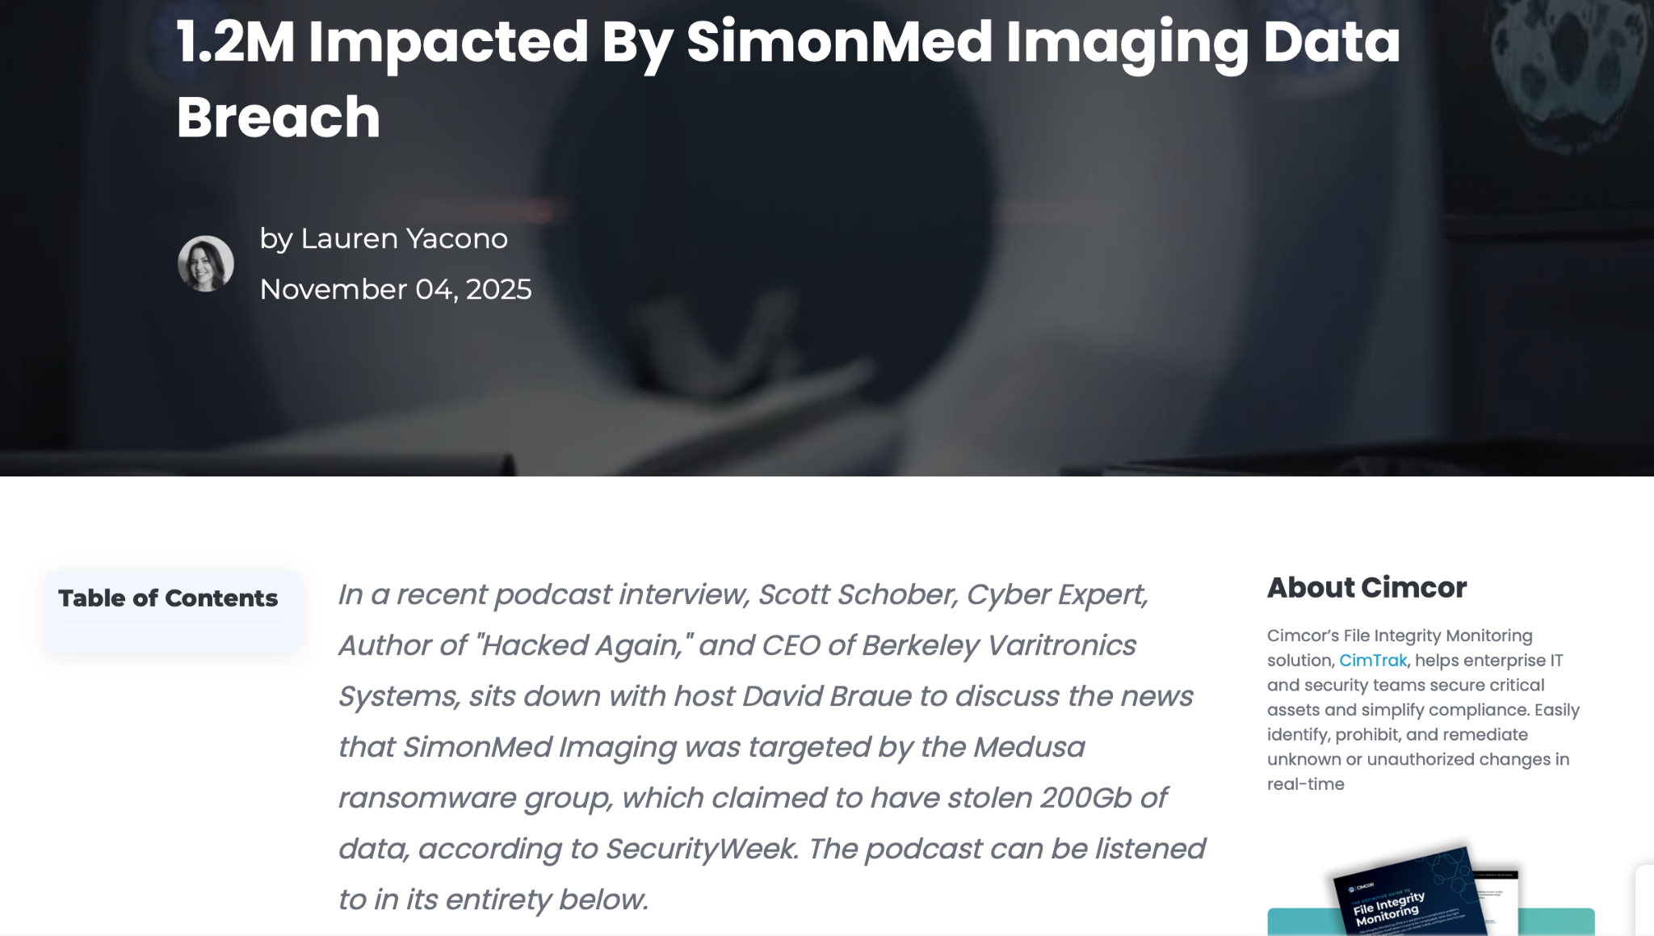
INTRODUCTION
Department of Electronics & Communication Engineering
www.cambridge.edu.in

Slide 5
INTRODUCTION
The rapid growth of IoT has shifted computation from cloud-centric systems to edge-based embedded platforms to achieve low latency and energy efficiency. FPGA-based devices, particularly the PYNQ-Z2, enable high-speed, low-power execution of compute-intensive tasks such as image processing and machine learning directly at the edge. However, transmitting large volumes of image data over wired and wireless networks introduces significant security risks, especially due to high pixel correlation and large data sizes that make conventional software-based encryption inefficient. Hardware-accelerated cryptography on FPGAs overcomes these limitations by exploiting massive parallelism, reducing latency, and lowering power consumption compared to CPU-based approaches. Integrating image encryption and hardware acceleration within a single FPGA framework ensures secure, real-time data protection at the edge, making it especially suitable for latency-sensitive and security-critical applications such as surveillance and healthcare imaging.
Department of Electronics & Communication Engineering
www.cambridge.edu.in

Slide 6
LITERATURE SURVEY
Sl. No | Title of the Research Paper | Authors | Year of publication | No of Citations | Challenges Faced
1 | Image Classification on PYNQ-Z2 Using ResNet20 and Tensil’s TCU | R. Jaimon, S. Sabu, S. John, A. Muhammed, N. S., V. K., A. Francis | 2025 | 1 | Limited by evaluation on only one CNN model and lack of real-time deployment analysis on diverse image datasets.
2 | Hardware–Software Co-Simulation of an AES-128 Based Data Encryption in Image Processing Systems for the Internet of Things Environment | K. Lata, S. Saini | 2020 | 12 | Co-simulation overhead challenges and power-performance trade-offs not optimized for low-resource IoT edge devices.
3 | A New Chaotic Symmetric Key Stream Cipher for Image Security in the Internet of Things | E. H. Y. Wajih, A. Abdelli, M. Machhout, F. Kharroubi | 2023 | 5 | Chaotic cipher increases computational complexity and may face synchronization issues in real-time IoT streams.
Department of Electronics & Communication Engineering
www.cambridge.edu.in

Slide 7
LITERATURE SURVEY
4 | Enhancement of Image using Verilog and MATLAB | C. S., N. P. H. L., P. V., S. M. | 2023 | 3 | The work focuses on image enhancement rather than encryption; it lacks integration with secure data transmission frameworks and does not address hardware performance or cryptographic security.
5 | Digital Image Scrambling Using Chaotic Systems Based on FPGA | A. J. Mansor, H. N. Abdalla, H. T. Ziboon | 2018 | 30 | The approach focuses mainly on pixel scrambling, which alone does not provide full cryptographic security and lacks comparison with standardized encryption algorithms such as AES.
6 | Hardware Implementation of Two Level Authentication Algorithm Using Cryptography with Steganography for Text-Image Security | P. Ghosh, S. Ghosh, H. Rahaman | 2024 | 8 | Combining cryptography with steganography increases security layers, but it adds implementation complexity and could lead to higher latency and resource usage on FPGA platforms.
Department of Electronics & Communication Engineering
www.cambridge.edu.in

Slide 8
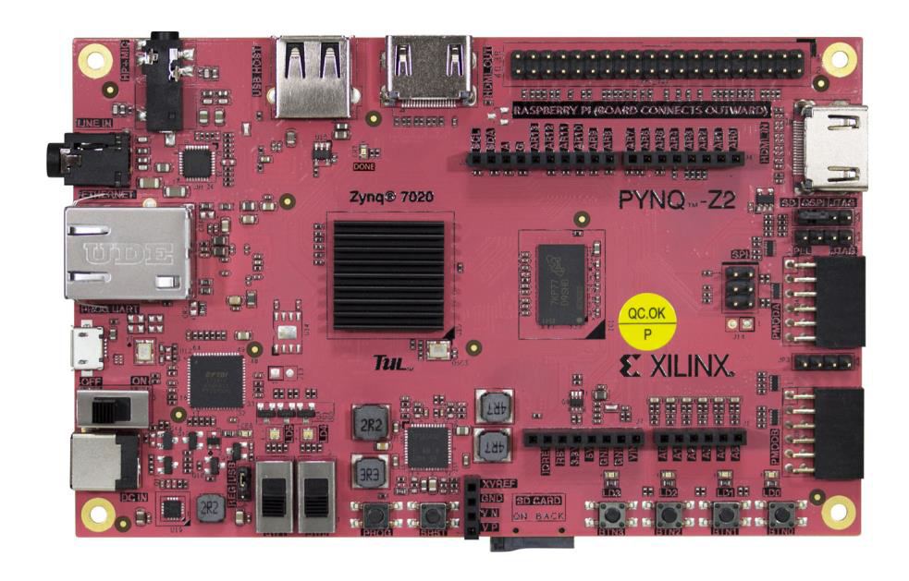
COMPONENTS REQUIRED
The PYNQ-Z2 is an FPGA development board based on the Xilinx Zynq-7000 SoC, integrating a dual-core ARM Cortex-A9 processor with on-chip programmable logic for heterogeneous computing.
It features the XC7Z020-1CLG400C device, offering an optimal balance of processing performance and reconfigurable hardware resources for embedded and edge-computing applications.
The programmable logic provides 13,300 logic slices, 220 DSP slices, and 630 KB of Block RAM, enabling highly parallel acceleration of compute-intensive tasks such as image processing and cryptography.
The ARM Cortex-A9 cores operate up to 650 MHz, managing high-level software functions including operating system services, Python execution, and system control.
Department of Electronics & Communication Engineering
www.cambridge.edu.in

Slide 9
COMPONENTS REQUIRED
The board includes 512 MB of DDR3 memory, directly interfaced with the Processing System to support high-bandwidth data access for both software and hardware accelerators.
AXI High-Performance (HP) ports enable low-latency, high-throughput data transfers between DDR memory and FPGA-based hardware IPs.
AXI Direct Memory Access (DMA) support allows efficient bulk data movement without CPU involvement, significantly reducing processor overhead and improving system performance.
Department of Electronics & Communication Engineering
www.cambridge.edu.in

Slide 10
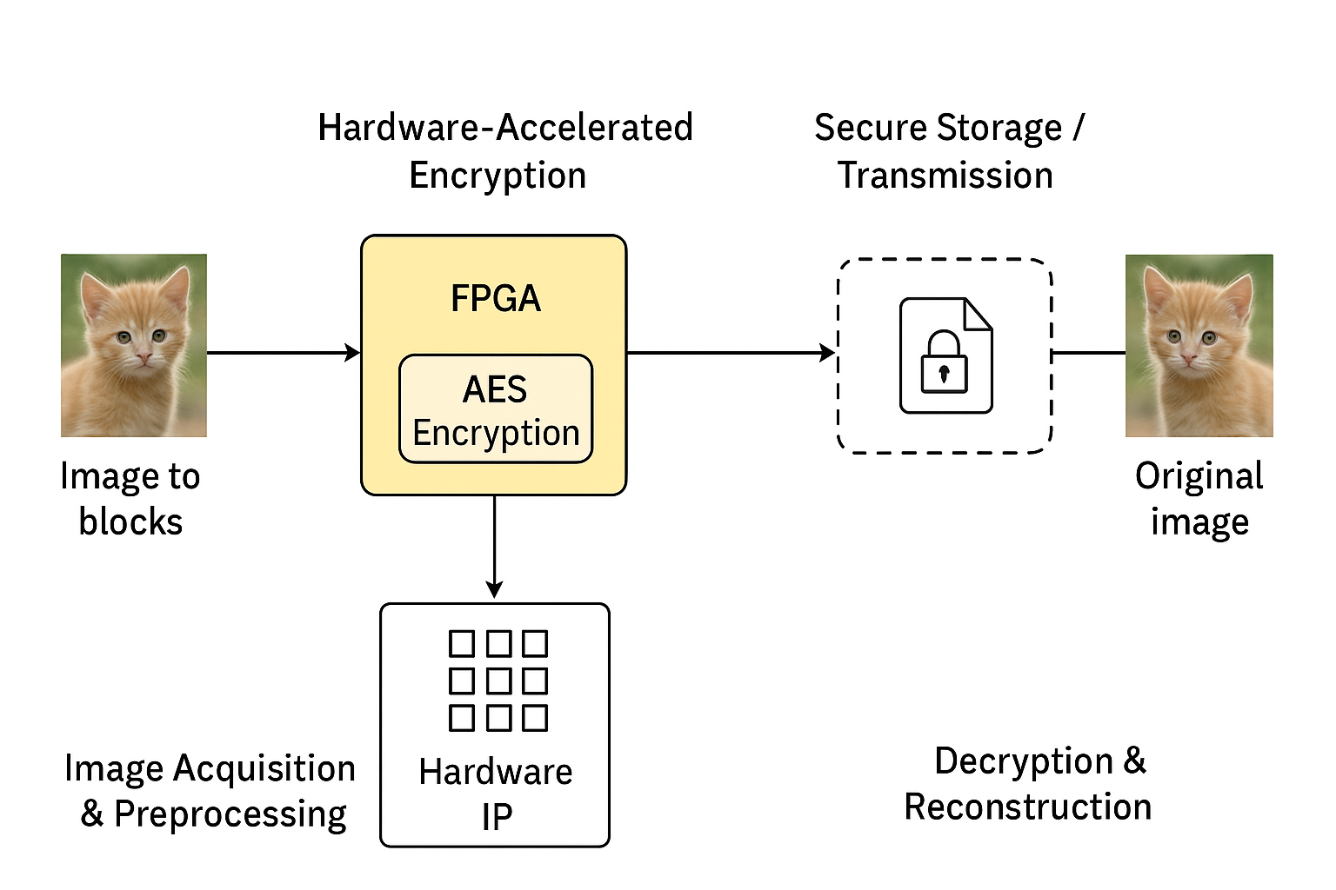
BLOCK DIAGRAM OF THE PROJECT
Department of Electronics & Communication Engineering
www.cambridge.edu.in

Slide 11
BLOCK DIAGRAM OF THE PROJECT
The system begins with image acquisition, where the original image is captured from a sensor, file system, or camera and prepared for processing.
During preprocessing, the image is converted into a suitable format (e.g., grayscale) and resized or padded to match encryption block size requirements.
The preprocessed image is divided into fixed-size blocks (typically 128-bit or 16-byte blocks) to match the AES encryption standard.
These image blocks are transferred to the FPGA for encryption, enabling parallel and high-speed processing.
Inside the FPGA, a dedicated AES Encryption core performs cryptographic operations such as SubBytes, ShiftRows, MixColumns, and AddRoundKey.
The AES core is implemented as a hardware IP, synthesized using HLS and optimized for throughput and low latency.
Hardware-based encryption allows multiple data blocks to be processed concurrently, unlike sequential software encryption.
Department of Electronics & Communication Engineering
www.cambridge.edu.in

Slide 12
BLOCK DIAGRAM OF THE PROJECT
The encrypted image blocks are sent to secure storage or transmitted over a network, ensuring confidentiality during data transfer.
Encryption at the hardware level protects image data before transmission, reducing vulnerability to network-based attacks.
On the receiver side, the encrypted data undergoes decryption using the same AES core in reverse mode.
The decrypted blocks are then reassembled to reconstruct the original image without any loss of information.
The FPGA-based approach ensures low power consumption, making it suitable for IoT and edge devices.
Overall, the architecture integrates image processing, encryption, secure transmission, and reconstruction into a single efficient FPGA-based framework for real-time secure image handling.
Department of Electronics & Communication Engineering
www.cambridge.edu.in

Slide 13
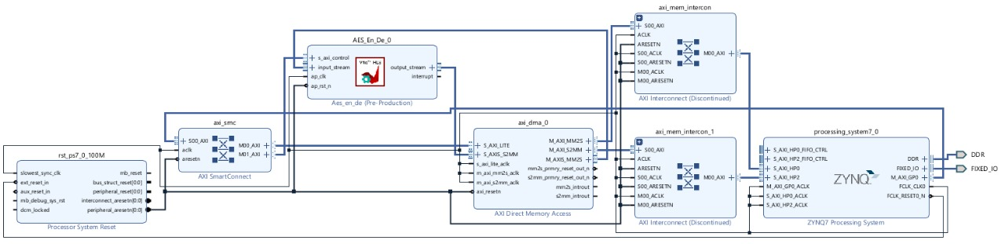
BLOCK DIAGRAM OF THE PROJECT
Department of Electronics & Communication Engineering
www.cambridge.edu.in

Slide 14
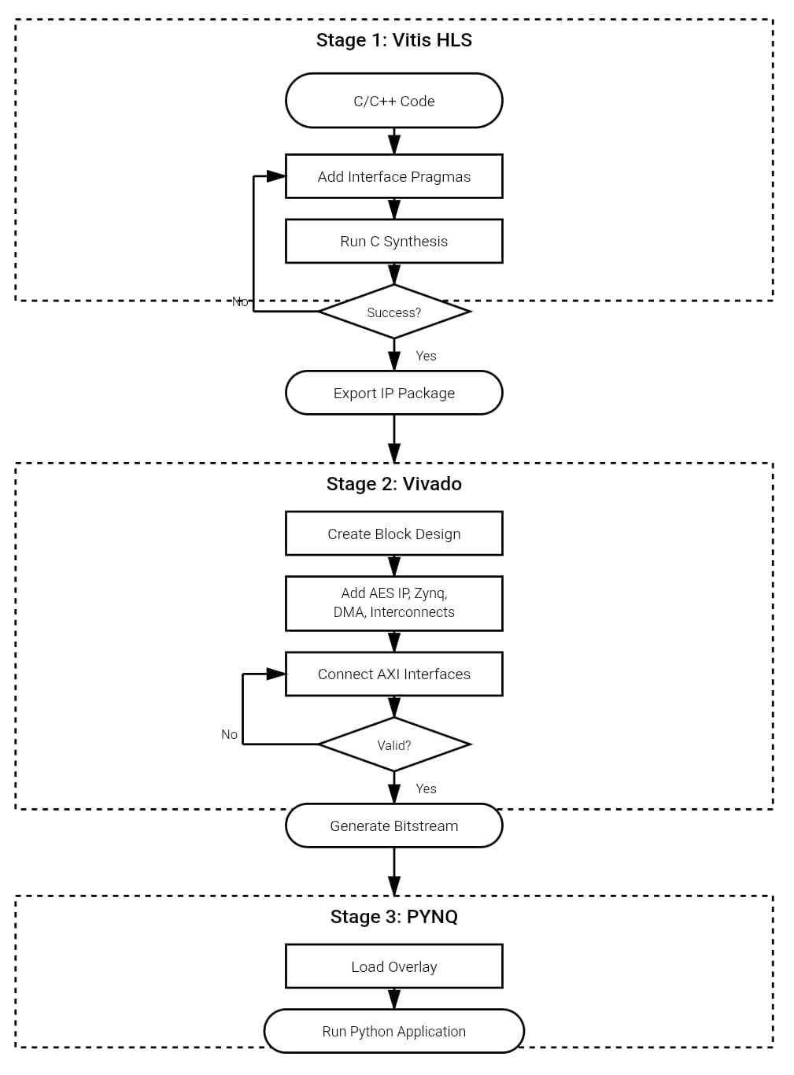
METHODOLOGY
Stage 1: Vitis HLS (IP Development)
Algorithm Definition: Develop the core encryption logic using standard C/C++ code, ensuring the algorithm behaves correctly before hardware translation.
Hardware Interface: Insert Interface Pragmas to optimize the code and define how data ports (like AXI streams) connect to the hardware.
Synthesis & Export: Run C Synthesis to convert the C++ logic into Hardware Description Language (RTL) and export the IP Package for use in Vivado.
Department of Electronics & Communication Engineering
www.cambridge.edu.in

Slide 15
METHODOLOGY
Stage 2: Vivado (System Integration)
Block Design Creation: Build the system architecture by integrating the custom AES IP with the Zynq Processing System (PS) and DMA controllers.
Bus Connectivity: Manually connect AXI Interfaces and Interconnects to establish high-speed communication paths between the processor and the encryption engine.
Bitstream Generation: Validate the block diagram for errors and synthesize the design to generate the final Bitstream (.bit file).
Stage 3: PYNQ (Deployment & Testing)
Overlay Configuration: Initialize the FPGA environment by loading the Overlay (the bitstream generated in Stage 2) onto the programmable logic.
Software Execution: Run the Python Application (typically in Jupyter) to manage data transfer and trigger the hardware-accelerated encryption.
Department of Electronics & Communication Engineering
www.cambridge.edu.in

Slide 16
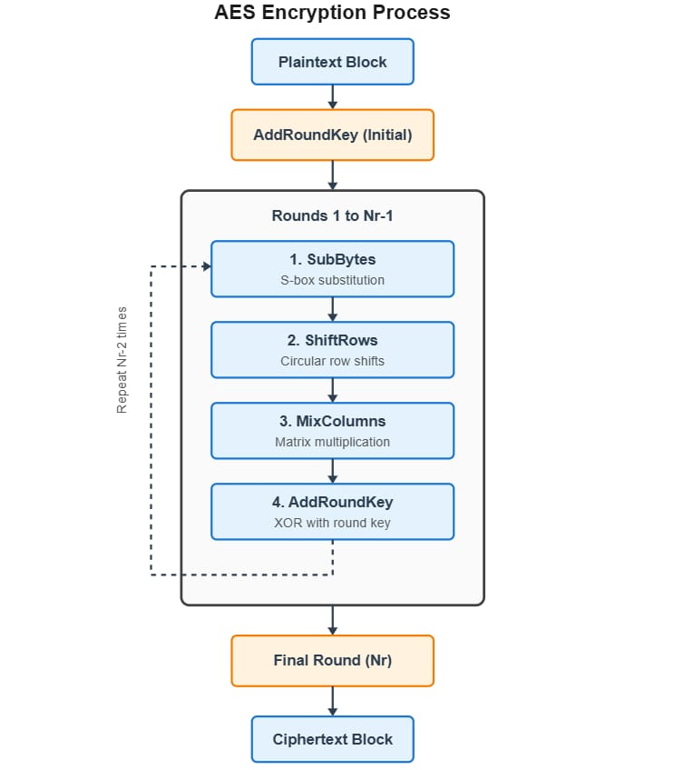
AES ALGORITHM FLOW CHART
The AES encryption process operates on a 128-bit plaintext block arranged as a 4×4 state matrix and starts with an initial AddRoundKey operation to mix the cipher key with the data. It then proceeds through multiple rounds (10 for AES-128), where each round applies SubBytes for non-linear substitution, ShiftRows for byte permutation, MixColumns for diffusion, and AddRoundKey for key mixing, while the final round excludes MixColumns to simplify decryption. A parallel key expansion generates round-specific keys, and the repetitive, structured flow enables efficient hardware implementation with pipelining and parallelism, making AES suitable for high-speed, real-time encryption.
Department of Electronics & Communication Engineering
www.cambridge.edu.in

Slide 17
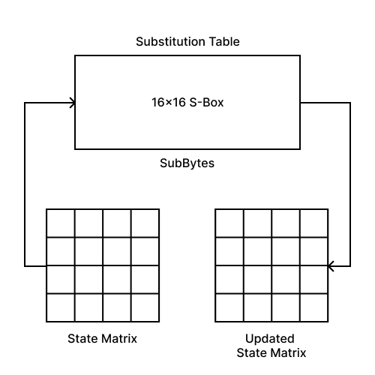
SUB BYTES
SubBytes is a non-linear byte substitution step where each byte of the 4×4 state matrix is replaced using a fixed AES S-Box, introducing cryptographic confusion.
This operation is designed to resist linear and differential cryptanalysis by breaking simple mathematical relationships between plaintext and ciphertext.
Department of Electronics & Communication Engineering
www.cambridge.edu.in

Slide 18
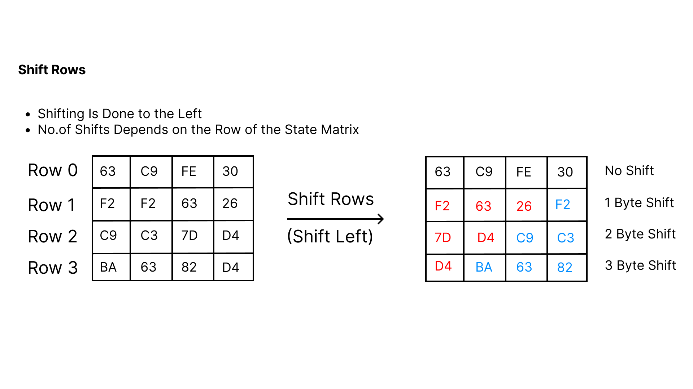
SHIFT ROWS
ShiftRows performs a cyclic left shift on each row of the state matrix, where the number of shifts depends on the row index (0, 1, 2, and 3 bytes respectively).
This step spreads byte dependencies across columns, preventing column-wise independence and enhancing diffusion in the encryption process.
Department of Electronics & Communication Engineering
www.cambridge.edu.in

Slide 19
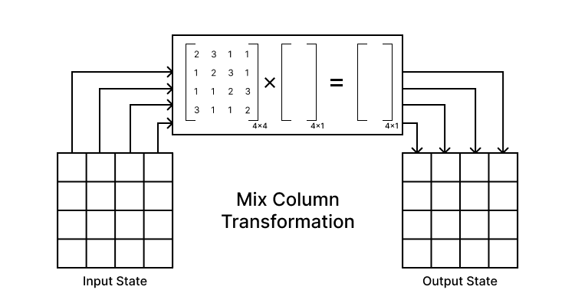
MIX COLUMNS
MixColumns treats each column of the state matrix as a polynomial and multiplies it with a fixed constant Matrix.
This operation ensures strong diffusion, meaning a single input byte affects multiple output bytes across the column.
Department of Electronics & Communication Engineering
www.cambridge.edu.in

Slide 20
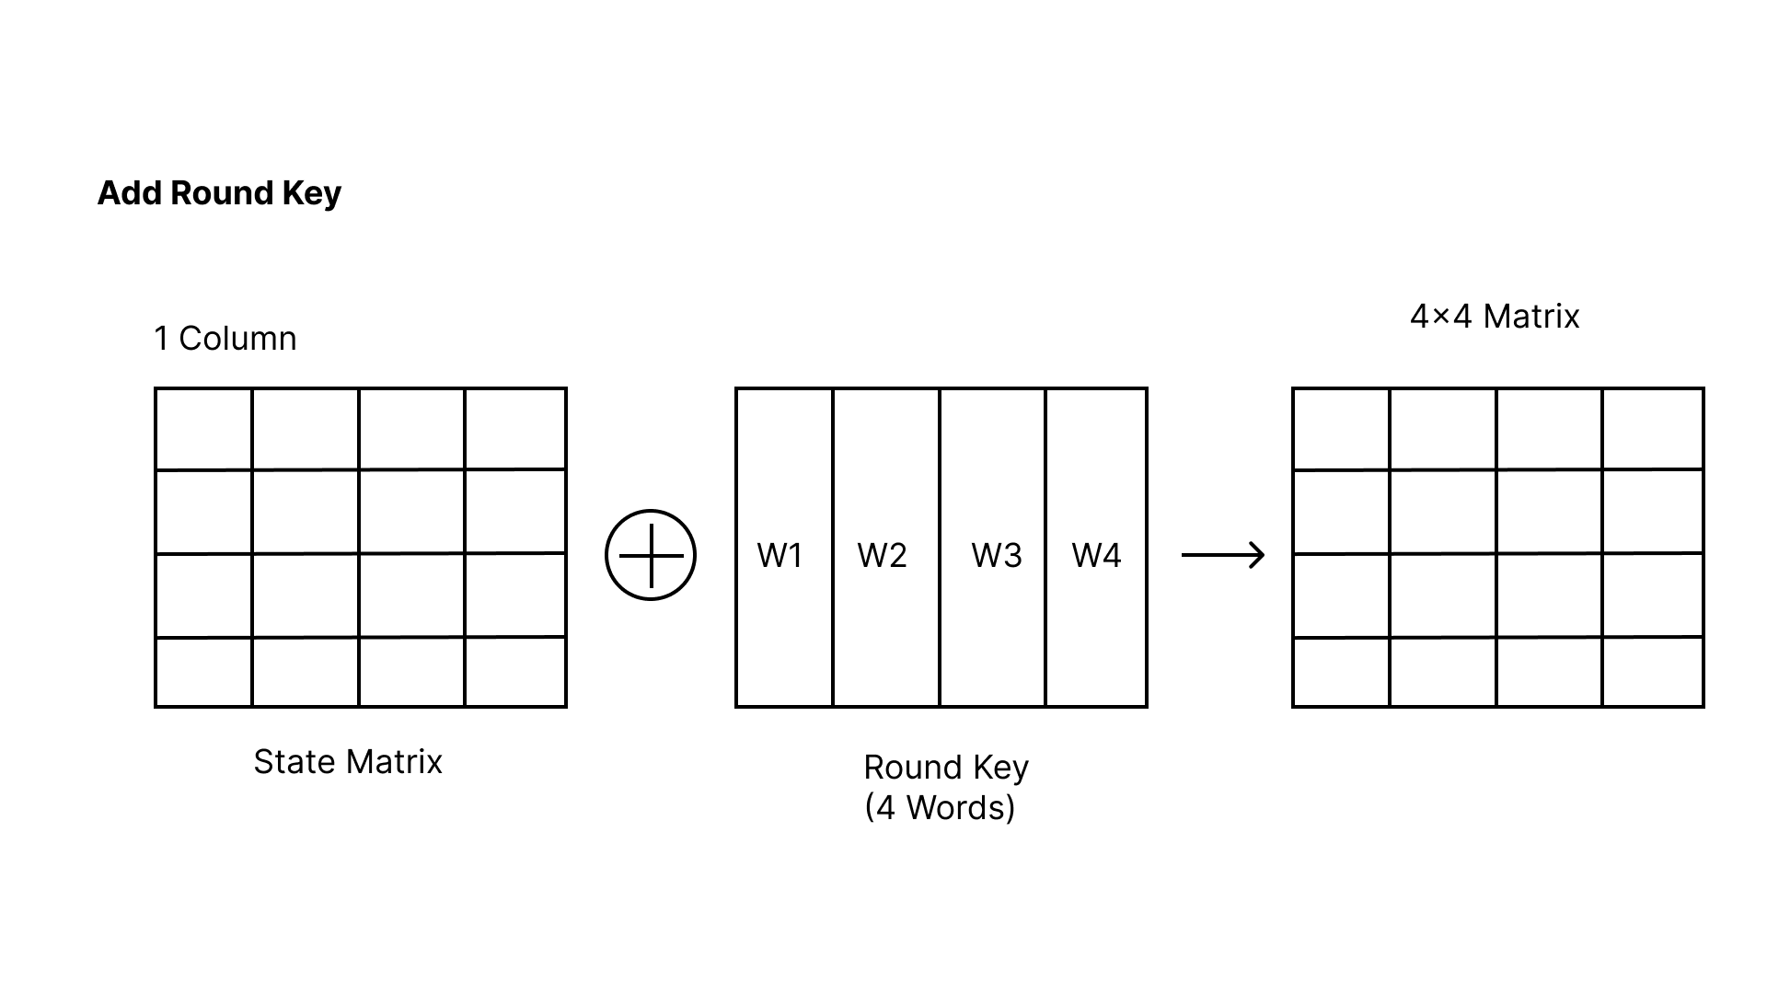
ADD ROUND KEY
AddRoundKey combines the current state matrix with the round key using a bitwise XOR operation, directly injecting key material into the data.
Since XOR is reversible, this step ensures secure key mixing while allowing correct decryption using the same round key.
Department of Electronics & Communication Engineering
www.cambridge.edu.in

Slide 21
PYTHON IMPLEMENTATION
Hardware setup
Loads the FPGA design AES_1.bit using Overlay, grabs handles to the AES IP (AES_En_De_0) and the AXI DMA (axi_dma_0), and creates an MMIO object to write control/config registers of the AES IP.​
Keeps the overlay/IP initialization at global scope so it happens once, not per encryption call (reduces overhead).​
Buffer reuse (performance)
Uses get_buffers(size) to allocate contiguous DMA buffers (PYNQ allocate) for a given chunk size and caches them in dictionaries, so repeated calls reuse the same buffers instead of reallocating.​
MAX_BUFFER_SIZE is set to 8 MB, so big images are processed in 8 MB chunks to fit buffer/transfer limits and improve stability.
AES call path (DMA)
call_AES_optimized(...) copies input bytes into the pre-allocated input DMA buffer, writes the key, data length, and encrypt/decrypt mode into AES IP registers via MMIO, then uses DMA to receive into out_buffer and send in_buffer (receive channel started first).​
It starts the hardware by writing to the control register, waits for both DMA channels to finish, and returns the resulting ciphertext/plaintext bytes.​
Department of Electronics & Communication Engineering
www.cambridge.edu.in

Slide 22
PYTHON IMPLEMENTATION
Padding + image wrapper
expand_to_128b_fast(...) pads any data to a multiple of 16 bytes (AES block size) by appending zeros.​
image_AES_optimized(...) converts the PIL image to raw bytes, pads them, processes them chunk-by-chunk through call_AES_optimized, measures total time + MB/s throughput, then reconstructs a new PIL RGB image from the processed bytes.​
Benchmark runner
benchmark_aes() loads ./images/parrot.jpg, does a small “warm up” encryption on a resized image, then encrypts the full image and decrypts it back, printing individual and total timings.​
If run as __main__, it executes the benchmark and displays original/encrypted/decrypted images in a notebook via IPython.display.
Department of Electronics & Communication Engineering
www.cambridge.edu.in

Slide 23
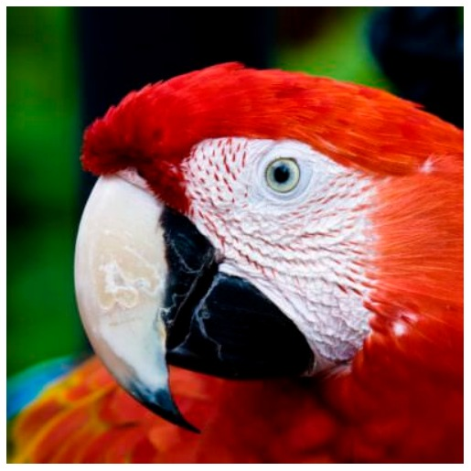
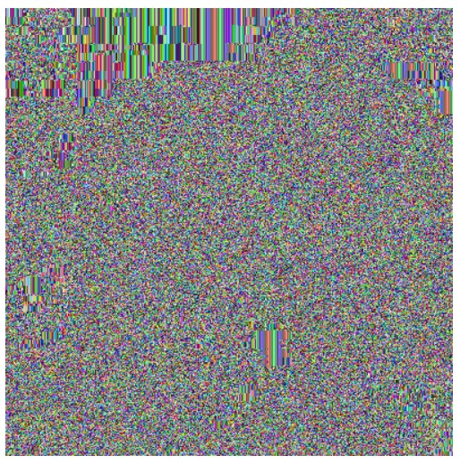
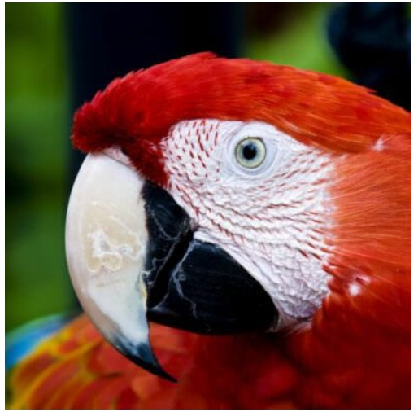
OUTCOME
Original Image
Encrypted image
Decrypted Image
Department of Electronics & Communication Engineering
www.cambridge.edu.in

Slide 24
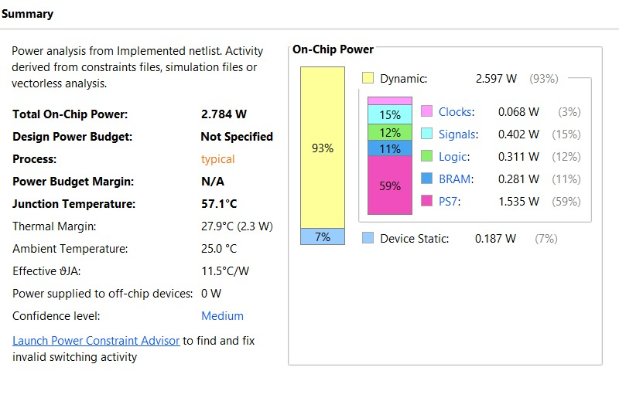
ON-CHIP POWER ANALYSIS
Key Metrics
Total On-Chip Power: 2.784 W
Junction Temperature: 57.1°C (Well within safe operating limits)
Thermal Margin: 27.9°C (Headroom available before reaching thermal limits)
Power Efficiency: Design is dominated by Dynamic Power (93%), indicating low static leakage.
Conclusion
The design operates safely at an ambient temperature of 25°C.
The effective thermal resistance is 11.5°C/W.
No thermal throttling or active cooling issues are anticipated based on current usage.
Department of Electronics & Communication Engineering
www.cambridge.edu.in

Slide 25
APPLICATION
1. Secure Telemedicine & Remote Consultations
Encrypted medical images (MRI, CT, X-ray) can be safely transmitted between hospitals and doctors over unsecured networks, ensuring patient confidentiality.
2. Cloud-Based Medical Data Storage
Before uploading to cloud servers, images can be encrypted on FPGA hardware, protecting data from unauthorized access or breaches.
3. Medical IoT Devices & Edge Security
Portable imaging devices (like handheld ultrasound scanners) can integrate FPGA-based encryption to secure patient scans in real-time at the edge.
4. HIPAA & GDPR Compliance in Healthcare Systems
Encryption ensures compliance with global healthcare data protection laws, safeguarding sensitive patient information during transmission and storage.
5. Military & Disaster Relief Medical Camps
In remote or high-risk zones, medical images can be encrypted using FPGA to ensure secure sharing with base hospitals, even over unreliable or hostile networks.
Department of Electronics & Communication Engineering
www.cambridge.edu.in

Slide 26
CONCLUSION
Implemented an efficient FPGA-based image cryptography system.
Achieved real-time, secure, and low-power operation.
Validated performance and correctness through experiments.
Combines Vivado HLS and Python-based control for simplicity and flexibility.
Department of Electronics & Communication Engineering
www.cambridge.edu.in

Slide 27
REFERENCES
[1] R. Jaimon, S. Sabu, S. John, A. Muhammed, N. S., V. K., and A. Francis, “Image Classification on PYNQ-Z2 Using ResNet20 and Tensil’s TCU,” 2025.
[2] K. Lata and S. Saini, “Hardware–Software Co-Simulation of an AES-128 Based Data Encryption in Image Processing Systems for the Internet of Things Environment,” I IEEE Int. Symp. Smart Electronic Systems (iSES), 2020.
[3] E. H. Y. Wajih, A. Abdelli, M. Machhout, and F. Kharroubi, “A New Chaotic Symmetric Key Stream Cipher for Image Security in the Internet of Things,” IEEE Int. Conf. Artificial Intelligence & Green Energy (ICAIGE), 2023.
[4] C. S., N. P. H. L., P. V., and S. M., “Enhancement of Image Using Verilog and MATLAB,” IRJMETS, vol. 5, no. 7, pp. 870–872, 2023, doi:10.56726/IRJMETS43063.
[5] A. J. Mansor, H. N. Abdalla, and H. T. Ziboon, “Digital Image Scrambling Using Chaotic Systems Based on FPGA,” in Proc. 3rd Scientific Conf. Electrical Engineering (SCEE), 2018, pp. 19–23.
Department of Electronics & Communication Engineering
www.cambridge.edu.in

Slide 28
REFERENCES
[6] P. Ghosh, S. Ghosh, and H. Rahaman, “Hardware Implementation of Two Level Authentication Algorithm Using Cryptography with Steganography for Text-Image Security,” in Proc. IEEE Int. Conf. Electron Devices Society Kolkata Chapter (EDKCON), 2024, pp. 105-110.
[7] S. Tiwari and P. R. Muduli, “Convolutional Neural Network-based ECG Classification on PYNQ-Z2 Framework,” in Proc. IEEE Int. Conf. Electronics, Computing and Communication Technologies (CONECCT), 2022, pp. 1–7, doi: 10.1109/CONECCT55679.2022.9865780.
[8] Zhang Q, Xue X, Wei X. A novel image encryption algorithm based on DNA subsequence operation. ScientificWorldJournal. 2012;2012:286741. Doi: 10.1100/2012/286741. Epub 2012 Oct 11. PMID: 23093912; PMCID: PMC3475302.
[9] S. Pedre, T. Krajn´ ık, E. Todorovich, and P. Borensztejn, “Hardware/Software Co-design for Real-Time Embedded Image Processing: A Case Study,” in Proc. IEEE Int. Conf. on Electron Devices Society Kolkata Chapter (EDKCON), 2012, pp. 7–14.
[10] Q. Ding, D. Liu, Y. Zhao, and Z. Ma, “Intelligent target detection and encrypted transmission system based on FPGA,” Computers and Electrical Engineering, vol. 128, art. No. 110653, 2025.
Department of Electronics & Communication Engineering
www.cambridge.edu.in

Slide 29
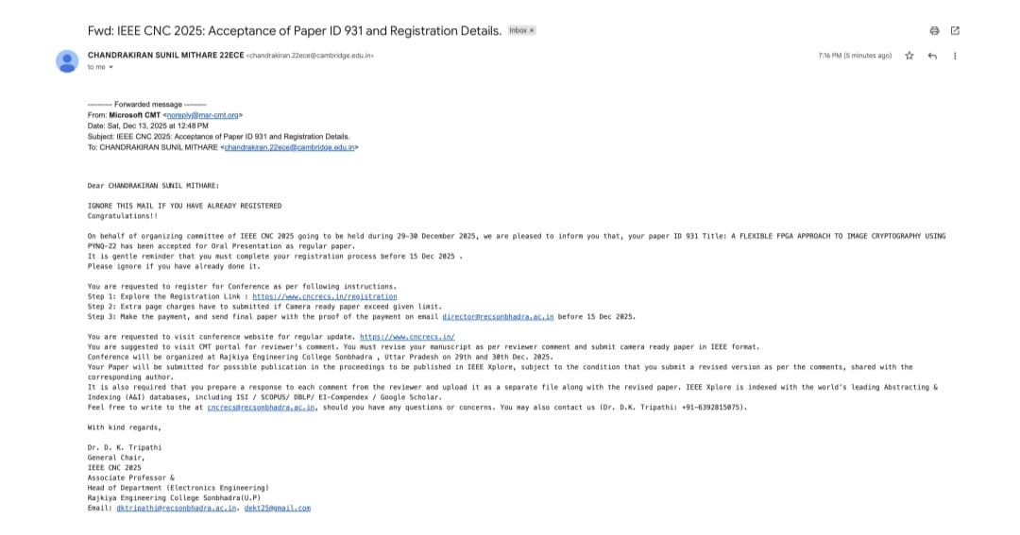
Department of Electronics & Communication Engineering
www.cambridge.edu.in

Slide 30
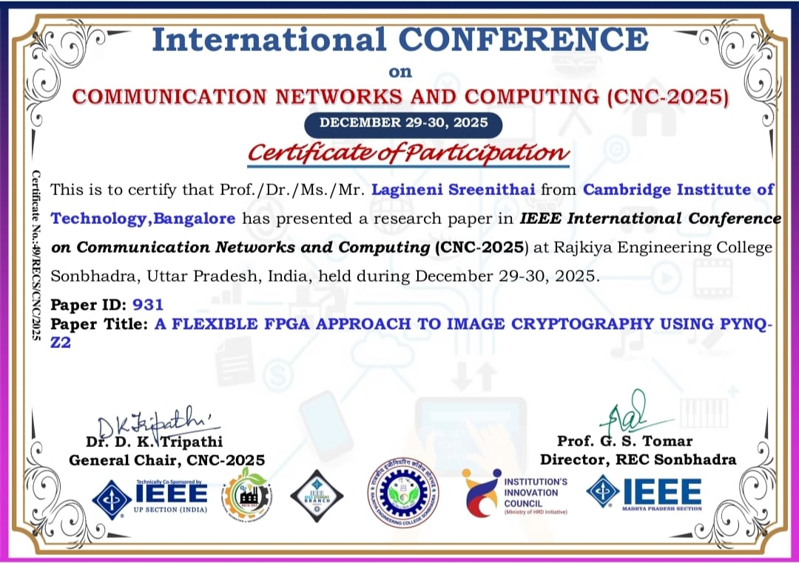
Department of Electronics & Communication Engineering
www.cambridge.edu.in

